Slide 1
Google that
Sample
Entry…

Slide 2
Think of something you have always wanted to know about…

Slide 3
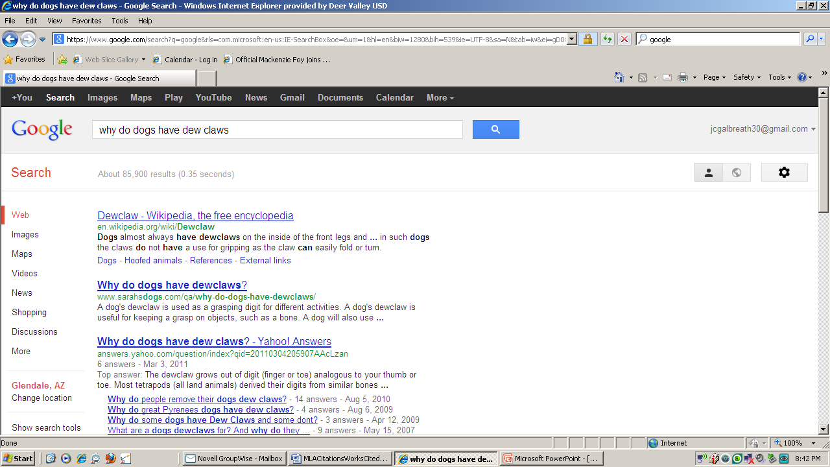

Slide 4
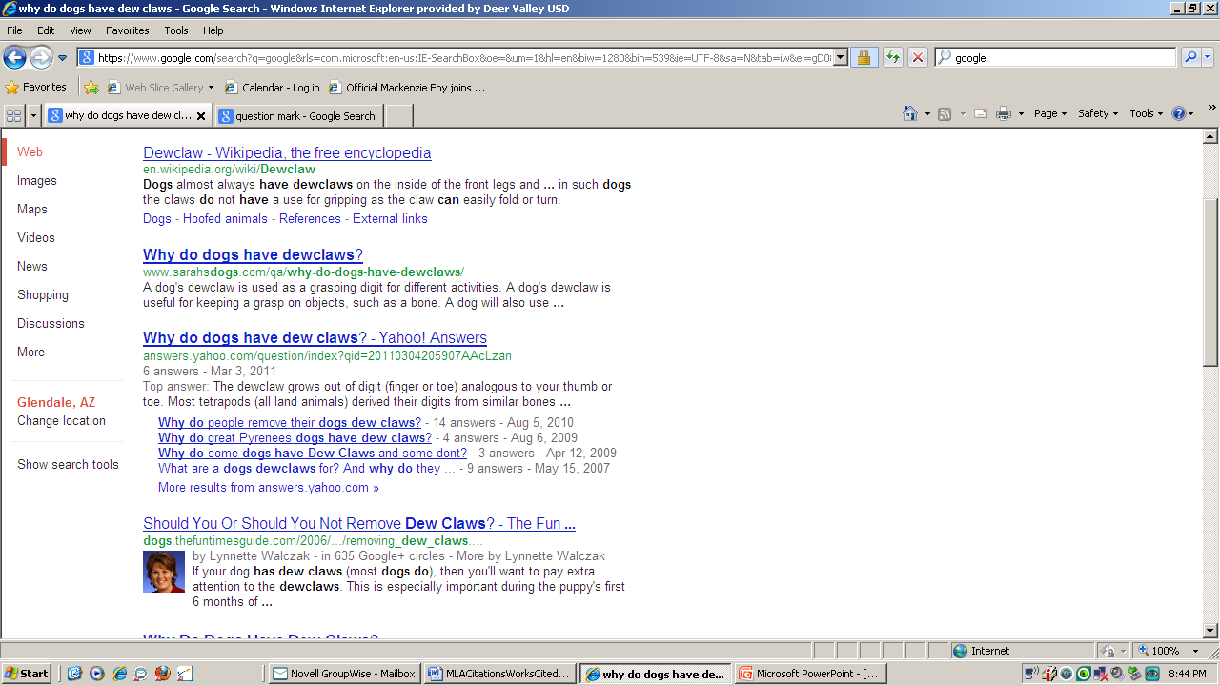
Scan for GOOD sites…
Not good!
Good?
Not good!
Good?

Slide 5
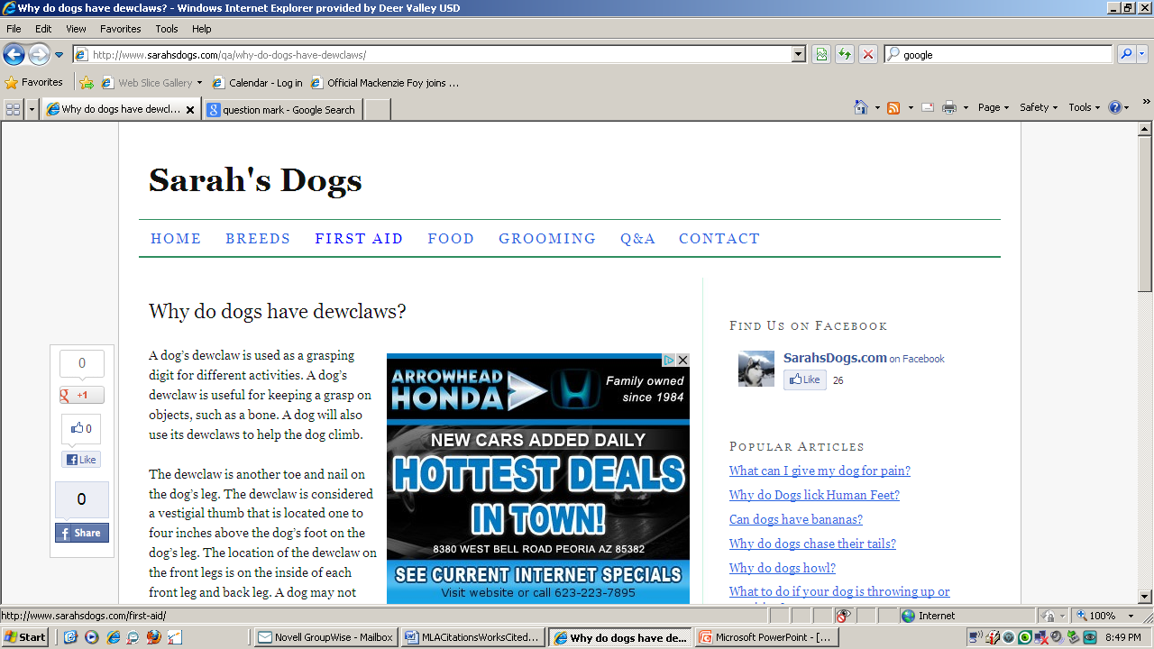
Select a site to read…

Slide 6
Read the article and see if it is something you can
UNDERSTAND!!!
It does you NO GOOD to read a confusing article.

Slide 7
Remember…you will put many of the sentences in
YOUR OWN WORDS!
So…read the information and start analyzing what you understand!

Slide 8
As you are reading, take notice of sentences that REALLY stand out that you wouldn’t be able to put in your own words!

Slide 9
If 1 site doesn’t give you enough information, go to another site and read MORE!

Slide 10
Can’t seem to STOP yourself from copying/pasting or writing what you read?
Try this:
*Read the info on the website
*Leave the room with the computer or turn it off
*Write your paragraph

Slide 11
Example entry:
Why do dogs have “dew” claws?
“The dewclaw is considered a vestigial thumb that is located one to four inches above the dog’s foot on the dog’s leg” (Sarah’s Dogs). Ironically, many dog owners and veterinarians remove the dew claw when the dog is a puppy (that will be an additional “Google That” entry). The dew claw on a dog allows the dog to grab a hold of things and helps them climb. According to some sources, the dew claw evolved from dogs who used to have five toes (Kathy Davison). Through evolution, the toe moved up on the leg to help the dog improve its running ability. The dew claw has to be trimmed just like any other nail on a dog, as it can get over grown and cause irritation or get caught on something and tear. With proper grooming, a dog’s dew claw can provide little to no problems and help them adapt to grabbing and holding certain items. Consider it…the “thumb” of the dog.

Slide 12
Bibliography Set Up:
Davison, Kathy; “Why do dogs have dew claws?” http://ezinearticles.com/?Why-Do-Dogs-Have-Dew-Claws?&id=4317404
www.sarah’sdogs.com

Slide 13
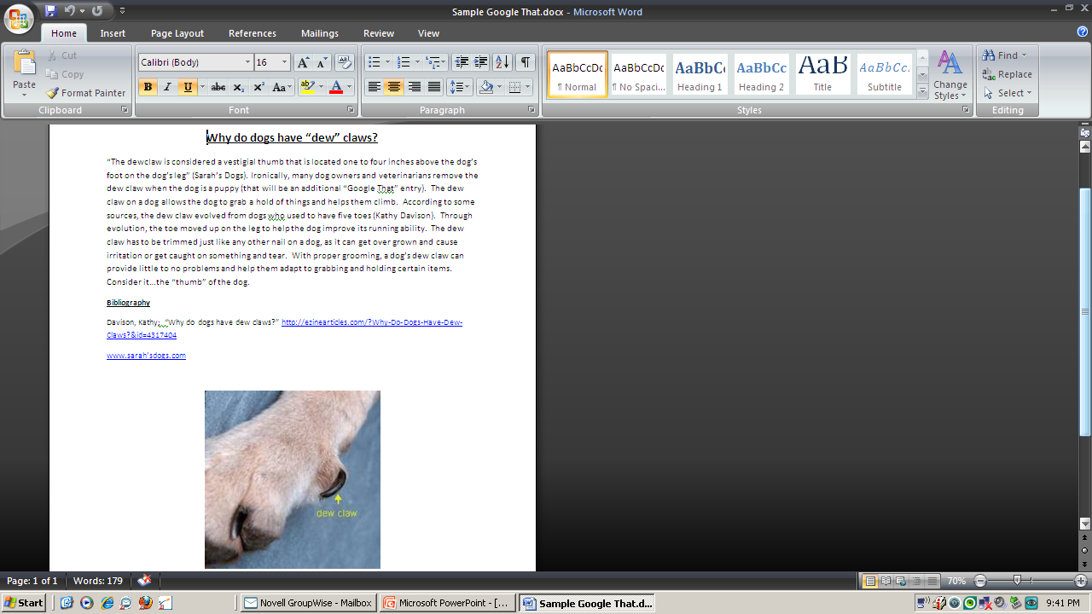
Final product sample:

Slide 14
Your Turn…
Working with your SHOULDER
PARTNER…you will be writing a Google That entry together.
I will provide your questions…
YOU will------->

Slide 15
*Research the answer on the ipad
*Read and understand the answer
*Find citations and paraphrased info for your summary
*Together write a 7-10 sentence summary of the answer including citations and paraphrased information on the mini dell
*create a bibliography
*add a picture
*both of you will use it as one of your 10 Google that entries ☺

