Slide 1
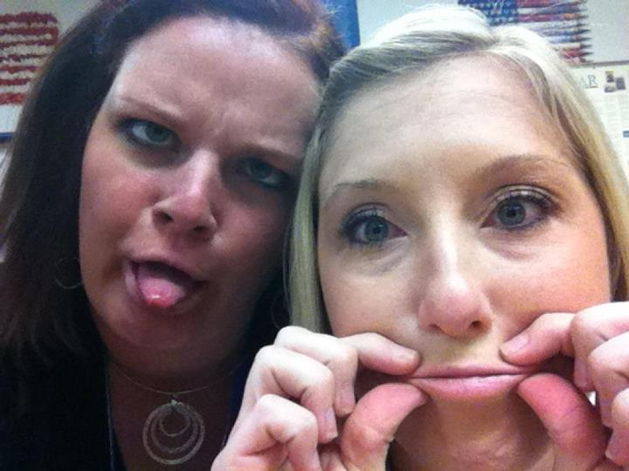
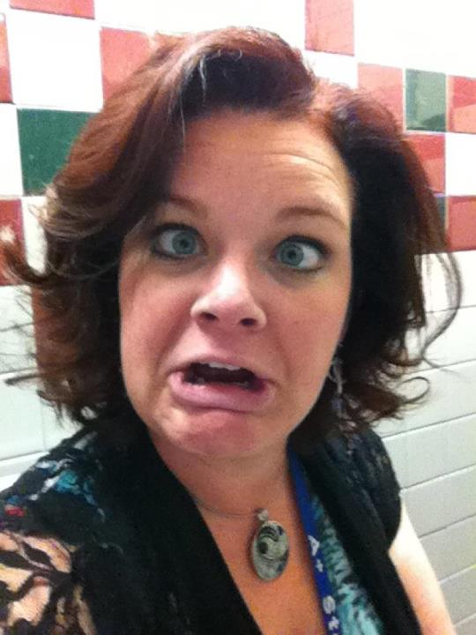
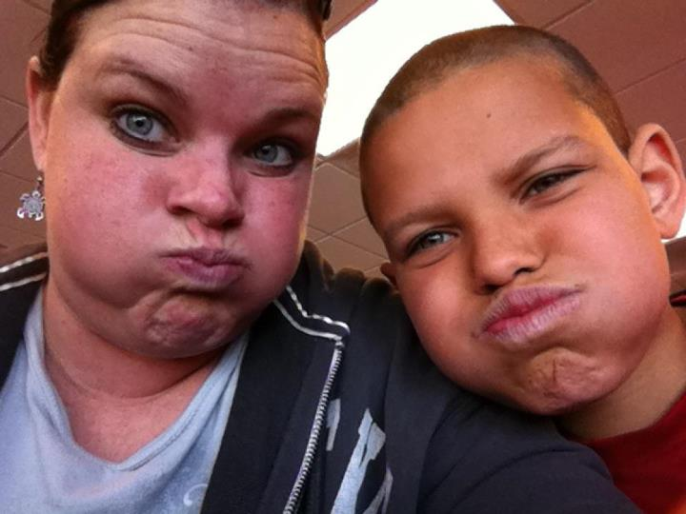
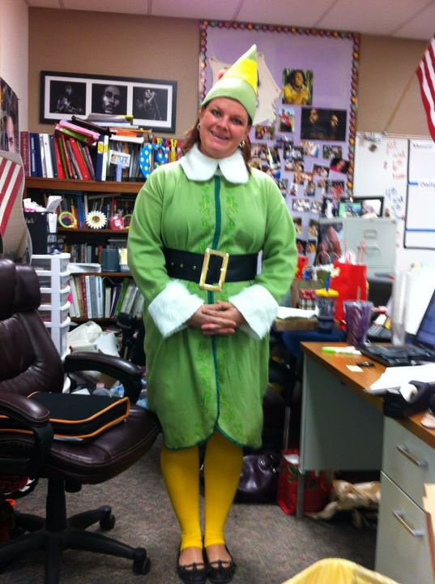
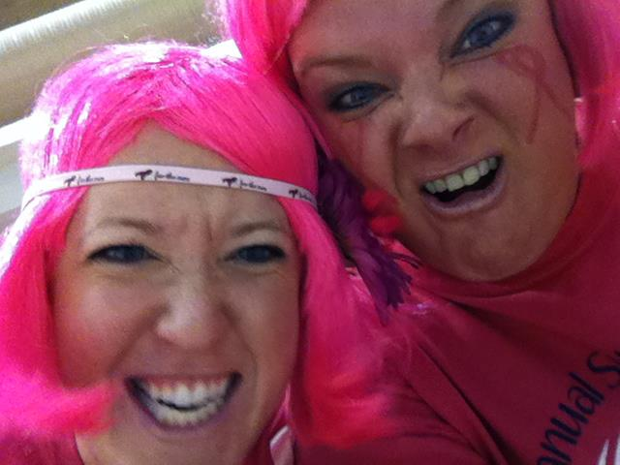
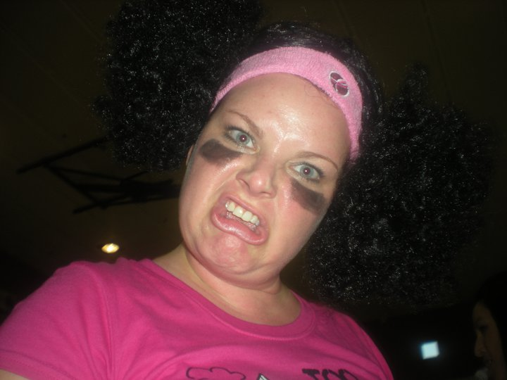
The MANY faces of Mrs. G…

Slide 2
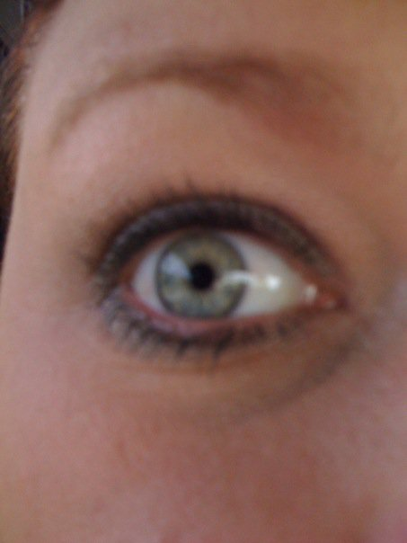
Let’s start with a little
Bit about me…so you can
Understand where I am
Coming from…

Slide 3
My Expectations:
#1---> PAY ATTENTION!
I DO NOT enjoy repeating myself. Once I walk over to the front of the classroom and get on my microphone, that is your cue that I am ready to teach and you need to be ready to listen.
#2---> GET TO WORK!
The art of multi-tasking is one that you WILL become familiar with by the end of the school year! You can WORK and enjoy my class at the same time. I have a LOT of information to give you and the more you use your time wisely, the better off you will be!
#3---> BE COOL!
I don’t think it is cool to be rude to people or mess with them or their personal items! I don’t expect everyone to be friends in my class, I don’t expect you to always get along, but I DO expect you to be cool and accept the fact that everyone is different and into their own thing. Leave them alone and they will leave you alone!

Slide 4
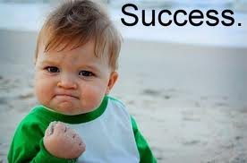
How to be successful in my class…
*READ the SMARTBOARD everyday-a few
times! Everything you will need to know for the day should be up there. Read the TAKE OUT area to see what you need for class.
*ASK questions! A good idea is to ask THREE before me. If you missed something or don’t know what is going on-ask someone at your table!
*DO YOUR WORK-and TURN IT IN ON TIME!!! I don’t take late work, so follow due dates and use class time wisely!
*CHECK your grades on POWERSCHOOLS OFTEN!!!

Slide 5
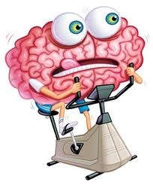
How we do things in Room 503
Warm Ups:
-We do warm ups everyday in my class. It is expected that you come in-send your Materials Manager to get the warm up (if it is a worksheet)-and GET TO WORK!
If it is not a worksheet, but
something you should already have,
then get it out and GET TO WORK!

Slide 6
Mondays & Wednesdays:
Dailies- This won’t be your favorite, but I promise you, they will help you with literature and grammar…and really that is why you are here ☺
Everyone at your table is responsible for completing the Dailies. You have 15 minutes to read the excerpt (short poem/story) and answer the questions.
IF you don’t understand one, ask your table team. If no one understands, leave it blank, because I go over them with you after the 15 minutes.
Fill in the answers when I give them to you, because you will NEVER know when I decide to take a grade on one!

Slide 7
Tuesdays & Thursdays
Flocabulary:
*This vocabulary program uses a song and 15 new words to enhance your knowledge.
*My regular classes do the 7th grade vocabulary and my advanced class does the 8th grade vocabulary.
-You will have TESTS every few weeks over the words, so it is important that you LEARN, UNDERSTAND, and STUDY them. ☺ I will explain this in detail next Tuesday.

Slide 8
Fridays
This Week in Rap
Fridays we will look at Current Events from the week. You will watch a video and do a collaborative activity with your table.
Again, you won’t know when I choose to take a grade on the activity you do, so DO YOUR BEST! ☺

Slide 9
What if I am absent?
While you are out, check my website for what we are doing. If you can do it while you are gone-DO IT! ☺
When you get back, go to my absent bin and find any worksheets I passed out while you were gone.
FIRST-ask a classmate for some help.
THEN-check with me for clarification!

Slide 10
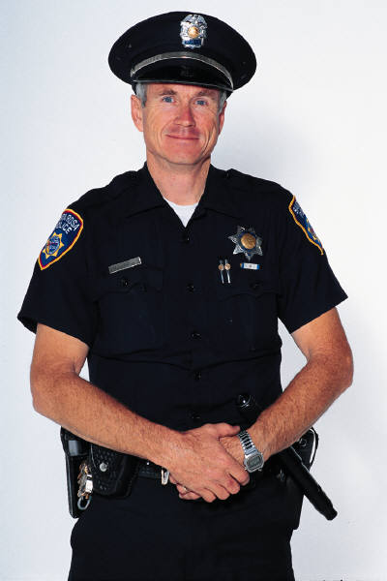
JOBS!!!
*Each of you will have a JOB at your
table team each quarter!
*It is IMPERATIVE that you do your job so the team runs smoothly!
*I will be writing down your JOB each quarter so YOU are accountable for what your card says you need to do!
*If someone is slacking on their job-tell them!

Slide 11
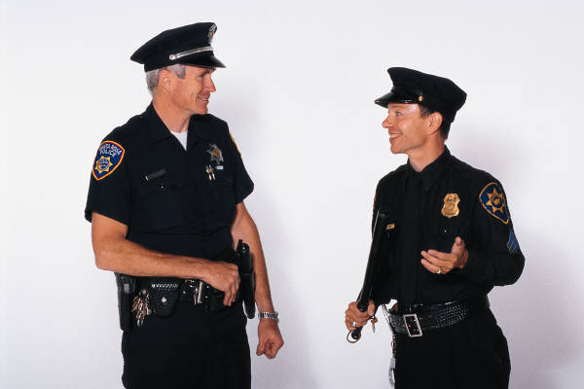
What are the jobs?
Group Leader
Materials Manager
Encourager
Time Keeper
Pull out the cards from your bin-so we can assign jobs!

Slide 12
Where do we turn in our papers?
*There is a drawer on the front table that is labeled (2nd hour, 3rd hour, 5th hour, 6th hour, 7th hour)
*Your MATERIALS MANAGER is in charge of turning in the WHOLE tables papers to the drawer!

Slide 13
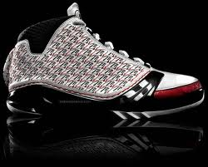
What if I need a pencil:
I don’t give out pencils-I loan them!
If you want a pencil from me, you will give me one of your shoes!
If I get my pencil back, you get your shoe back!
☺
Simple as that!

Slide 14
Where to find stuff:
Band-Aids: On my desk in a basket-help yourself…if you are actually cut!
Tissues: By the sink and on the back counter…help yourself.
Paper: If I have any, it is on the front table by the bins where you turn in your papers.
Pencil Sharpener: The trick is to sharpen towards you-it is on backwards!

Slide 15
Things that drive me NUTS:
Coming in my room before being invited!
Trying to be funny when you aren’t
Messing with other people and their stuff
Being petty!
Touching my stuff!
Not cleaning up after yourself!
TABLE WARS!
ROAMING MY ROOM!

Slide 16
Things I LOVE
Coming in and getting out your materials and being ready to work!
Raising your hand & Waiting to be called on! ☺
Waiting until I am at my desk working to ask me questions
Being CHILL!!
Random Acts of Kindness
Cleaning up after others without being asked to and not expecting anything for doing it!

